Slide 1



TEAM NAME:
Code Blazers

Slide 2
Problem Statement
Customer credit rating using social media analytics
Borrowers try to usually take loan from financial institutions. This has worked for quite some time, but there are many individuals who has good financial power and are looking for lending their money i.e P2P transactions. These classification product will help them to detect potential defaulters/candidate by using customer’s social media data.
Financial Institutions can also use this product to determine the potential customer/willful defaulters.

Slide 3
Describe your solution
We took the customer information which basically comprises of the customer’s credit information, personal information ,job information, social media information and tried to come to a model where it predicts whether the customer is a defaulter or not .
So here we have used the customer network information such as the social exposure, social network quality, social exposure and the twitter account in order to know about the customers social media information, so we have used the twitter API to fetch tweets based on hashtags and then tried to apply sentiment analysis on those tweets and then give these as one of the model input which could be used to predict the output
Technology Stack used
Pycharm, python
Watson studio
Skit-kit learn
Matplotlib
seaborn

Slide 4
Architecture
Used twitter API to fetch tweets
Used sentiment analysis
Network information
EDA
Integrate the csv
Used best algorithm for model prediction
Used Jupyter notebook

Slide 5
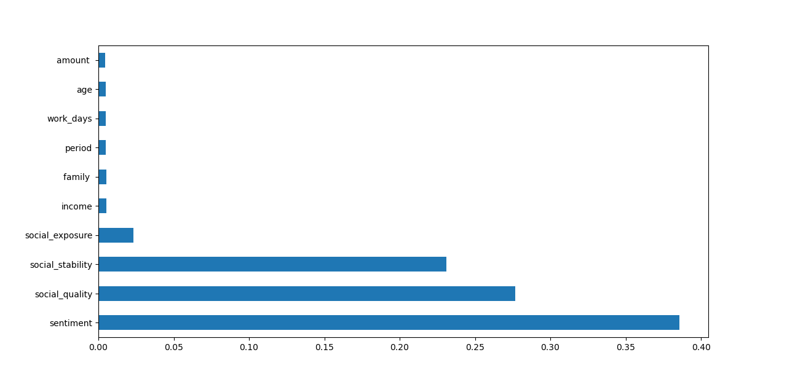
Feature Selection

Slide 6
Use Cases & Business Value of the solution
There are can be various use cases for these. Some of them we analyzed are
New User: A user asking for loan for first time.
The bank user will enter a name in the system. The product will search using the mobile number and will scan his last 5 or 10 years of data and will try to analyze his spend details. System will try to identify his personality by looking his post/tweets/images etc. The product will also scan through his contact list details and will try to find out defaulters.
2. Willful Defaulters:
These users are existing customer who has borrowed money from institution. System can scan through their social data and try to find out about their current status. Eg: Suppose a person has not paid his EMI for past 3 months but he his posting his new Car purchase on social media. System can make an alert o such customers to take an appropriate actions.
3.P2P Transactions:
There are individuals who has enough financial power and wants to do P2P transaction
. The system can help such individuals to identify the right customer without going through traditional Credit rating analysis.
P.S We are considering that we will get the data from various social media accounts of the customer.

Slide 7
Salient features & Future Scope
Model can be helpful for both the financial institutions & P2P lenders In predicting the defaulters.
Social media information can be a big breakthrough in the coming days for all the individuals to get loans easily.
It would also help individuals to improve on their social life if their application is rejected.
In this use case we have used twitter data in order to identify the personality of a customer, this could be extended to other social media platforms like facebook, Instagram, snapchat linkedin etc
This would give a holistic view about the person and build a strong portfolio of the customer which then could be used to give loans.

Slide 8
Challenges & Learnings
Learnings:
We were shown a completely a new way to see social media data. The domain itself possess a lot of possibility from character definitions, his spending details etc.
We got an opportunity to explore IBM cloud and it’s AI/ML services which can help us to do modelling of data in easy manner.
Social media data could also be a breakthrough in lending business in near future
Challenges:
We had an idea to use many IBM cloud services for our model but due to some technical issues were not able to explore more in that services.
To connect with the team members remotely and try to accomplish the task
To prepare the Dataset for this use case as it was not available on the web

